Slide 1
Verbal Feedback for Visually-Impaired and Blind People
By Li Breite and Mitko Nikolov

Slide 2
Overview - What is our project?
Analyze pictures
Microsoft Azure - Computer Vision API
Answer questions about pictures
Android App

Slide 3
Overview - Why our project?
Help people
Friends of Mitko’s who are blind
Help in everyday life
Examples of uses
Precursor to an actually useful app

Slide 4
Microsoft Computer Vision API
Analyze pictures
Tags, Description, Faces, Landmarks, Celebrities
For more info: https://azure.microsoft.com/en-us/services/cognitive-services/computer-vision/
Notes:
Microsoft Computer Vision API: https://azure.microsoft.com/en-us/services/cognitive-services/computer-vision/

Slide 5
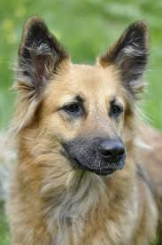
Microsoft Computer Vision API
Notes:
Image from https://encrypted-tbn0.gstatic.com/images?q=tbn:ANd9GcSaw1wdMFYiLifSE4owjIUSuwlJ-2DuX5qoQQI3E_34GoP7LviZ
Accessed from the Creative Commons License

Slide 6
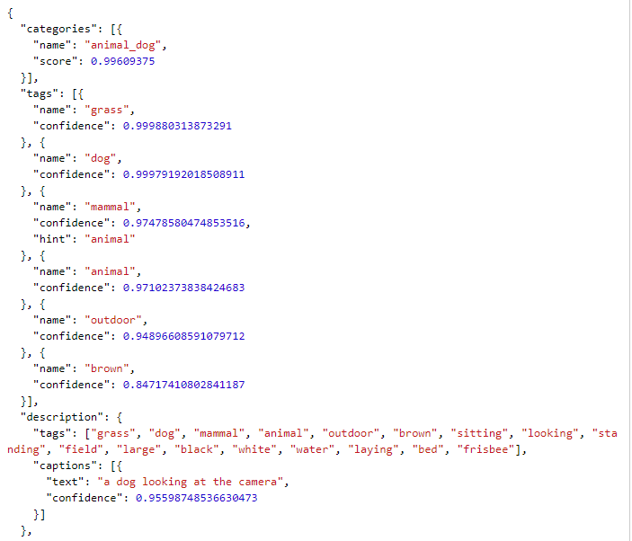
Microsoft Computer Vision API

Slide 7
Methodology
Data Set and Preprocessing it
Data Features
Methods

Slide 8
Data Set
Brown University Corpus of Present-Day American English
Form A
Reference:https://raw.githubusercontent.com/nltk/nltk_data/gh-pages/packages/corpora/brown.zip
Data organization across files and categories
Taking advantage of it
Preprocessing
Preprocessing that was already done for us
Preprocessing that we performed

Slide 9
Data Features
Features we used
Word ordering
Number of repetitions
Categorization
Features that were ineffective
POS tags

Slide 10
Methods
Methods already implemented in the work done so far
Language model
Android application
Methods that will be experimented with in the final weeks of the project

Slide 11
Methods
SEP
OCT
NOV
DEC
Brainstorm
Language Model
Language Model &
App Implementation
Finalizing App design and SEMPRE Integration. Packaging
Chose what to work on
Researched work in the field
Researched available software that we could use
Preprocessed data
Developed a language model
Implemented smoothing
Implemented UNK and interpolation smoothing
Fine-tuned interpolation vars
Performed intrinsic testing
Understood MS Comp. Vision API Doc
Tested MS Comp. Vision API
Implemented an application that queries the API
Learned how to perform semantic parsing
Embedded SEMPRE
Performed initial SEMPRE tests
Final changes on the design of the Android APP
Finish the SEMPRE Integration
Map semantic parsing to functionality of the Application
Experiment with MS Comp. Vision API data parsing
Package

Slide 12
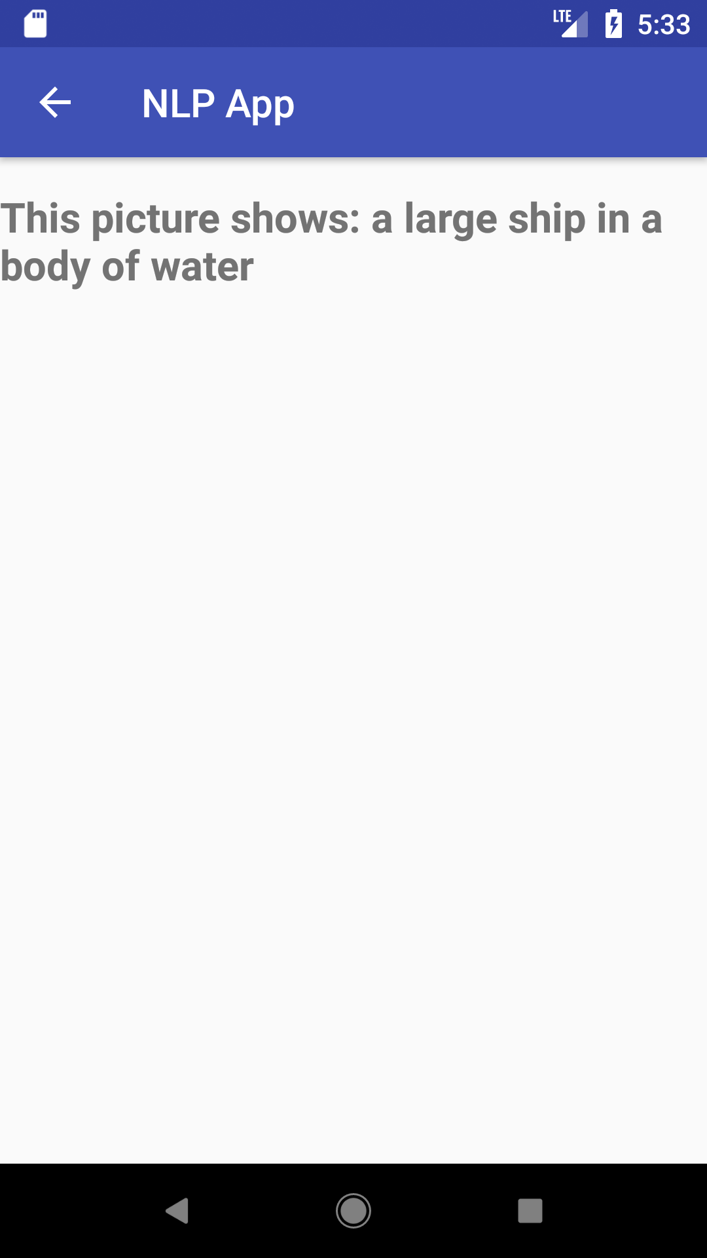
Current look of the application

Slide 13
Experimenting
Data Sets
Evaluation
Intrinsic
Perplexity
Interpolation
Deriving the best combination of unigrams, bigrams and trigrams
Planned future experiments

Slide 14
Data Sets
Size
Training - 70%
Development - 10%
Testing - 20%
Proportions of used files across categories
Different numbers of files from various categories
Used the percentages above in order to prevent the Lang. Model from learning more in one field than in another

Slide 15
Evaluation - results
Perplexity
Our perplexity for test files from some categories (like news) is as low as 84 and for other varies around a 96.
When we run the evaluation method on all the test files we have, the perplexity we get is 93.

Slide 16
Evaluation - results
Interpolation
Using the perplexity method and the development set, we experimented with different values for unigram, bigram and trigram data to perfect our interpolation smoothing
We found that the best proportion between the different data was:
Unigrams | Bigrams | Trigrams
0.14 | 0.25 | 0.61

Slide 17
References
Microsoft Azure. “Computer Vision API.” Computer Vision-Image Processing and Analytics, Microsoft Corporation, https://azure.microsoft.com/en-us/services/cognitive-services/computer-vision/.
Francis, Nelson and Kucera, Henry. “Brown Corpus : Nelson Francis and Henry Kucera : Free Download & Streaming.” Internet Archive, Brown University, 1 Jan. 1964, https://archive.org/details/BrownCorpus. The corpus is being used under Creative Commons License (https://creativecommons.org/licenses/by-nc/3.0/)
Subramanya, Amar, et al. “Google Code Archive - Long-Term storage for Google Code Project Hosting.” Google, Google, 1 Oct. 2012, https://code.google.com/archive/p/wiki-links/.

Slide 18
Questions?

